Slide 1

Can You Feel the Beat?
Measuring the quantum beat
Shivam Suthendran (20499543)

Slide 2
Summary of Contents
PREMISE AND MOTIVATION | Building blocks | Block assembly and analysis | results
Indistinguishability | The Photon | Second-Order Correlation Function - Detecting the Quantum Beat | Conclusions
Plan of Attack | Hong-Ou-Mandel (HOM) Experiment | Probability Distribution - Interpreting the Probability Distribution | Future Considerations
 | Second Order Correlation Function |  | Acknowledgements

Slide 3
The Question of Indistinguishability
Can you tell me about the final particle trajectories?
What if they were quantum particles?

Slide 4
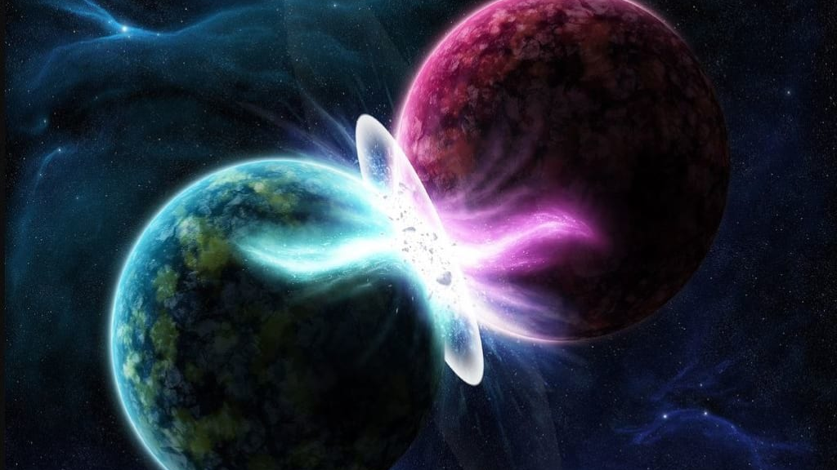
Photon Indistinguishabilty
Quantum Computing requires the generation of indistinguishable entangled photon pairs
How does one determine photon distinguishability?
https://miro.medium.com/max/1024/1*twIJrqreLpie6__bnqE9rg.png

Slide 5


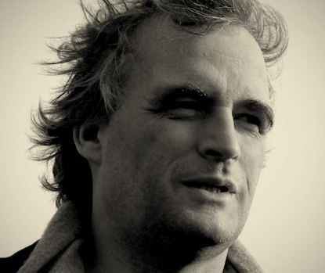
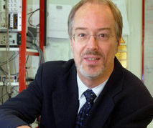
Plan of Attack - Motivation
“Time- Resolved Two-Photon Interference”
by Legero, Wilk, Kuhn, and Rempe (LWKR):

Slide 6
Plan of Attack
Demonstrate Quantum Beat
Compare Probability Distributions Found with Idealized HOM Probability Distribution

Slide 7





Plan of Attack - Process
“Signatures of Hong-Ou-Mandel Interference at Microwave Frequencies”
by M. J. Woolley, C. Lang, C. Eichler, A. Wallraff, and A. Blais (WLEWB)

Slide 8
Plan of Attack - Process
Perform Hung-0u-Mandel Experiment on Incident Photons
Determine Associated Second Order Correlation Function
Integrate Second-order Correlation Function Over all Possible Detection Times

Slide 9
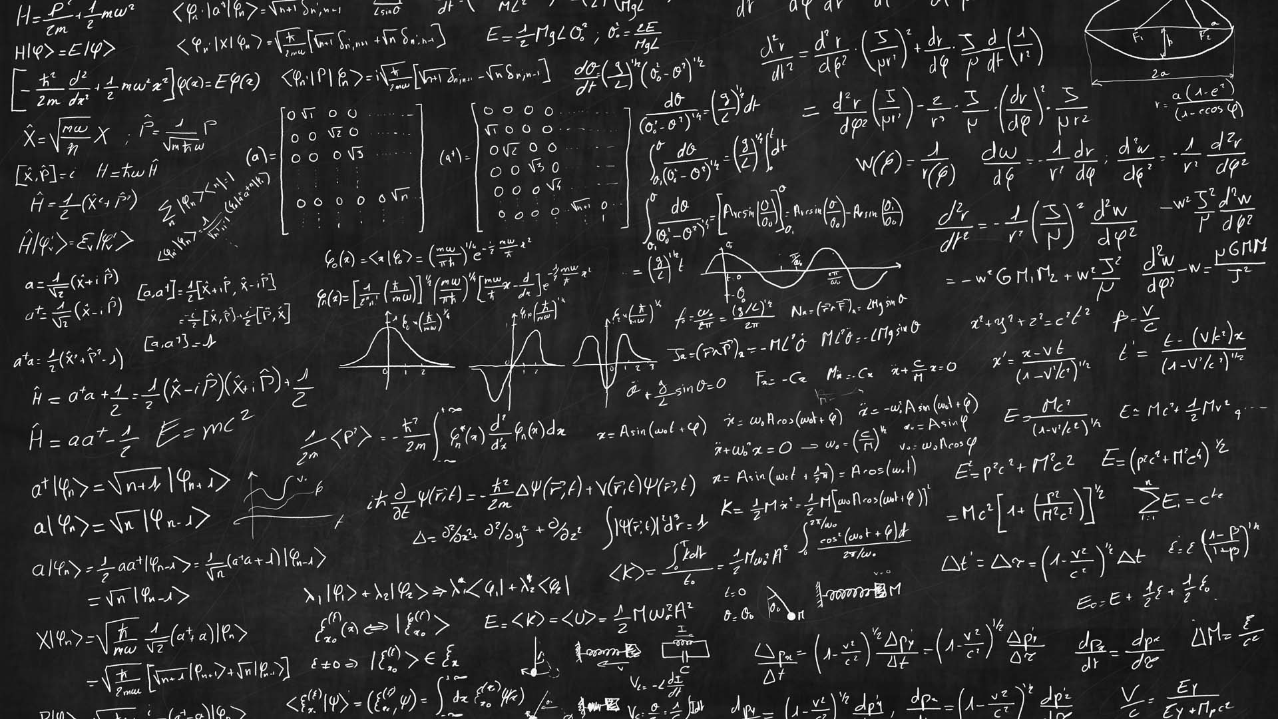
Plan of Attack – What is Needed
Shape of the Photon
Hung-Ou-Mandel Experiment
Second Order Correlation Function
https://www.gettyimages.ca/

Slide 10
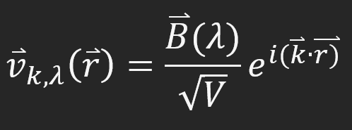
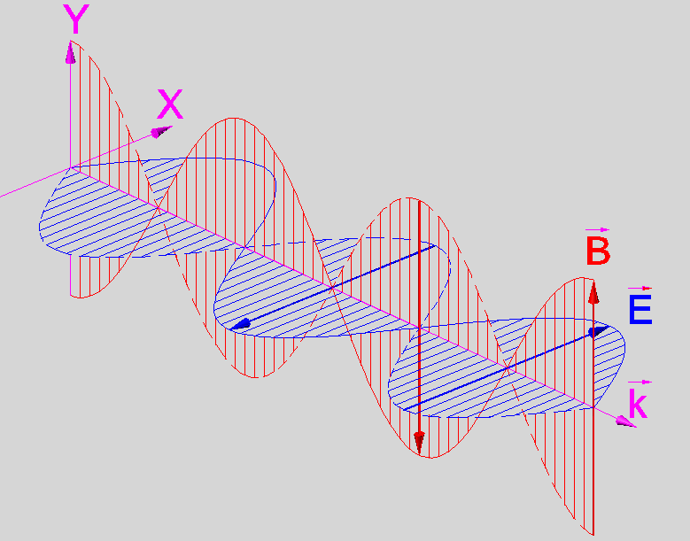
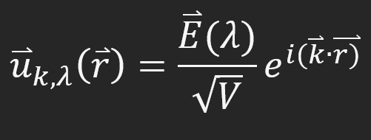
The Photon - 1
Natural fit for the harmonic oscillator framework
But there is a small problem!
This is Polarization Dependent

Slide 11
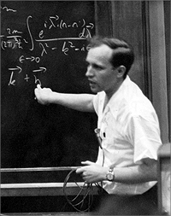
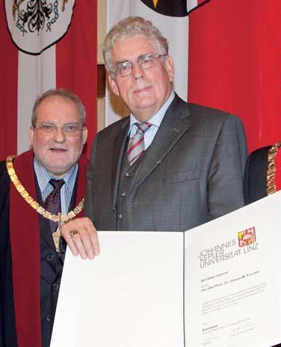
The Photon - 2
“Density Operators of Coherent Fields”
R. J. Glauber and U. M Titulær (GT)
Found Relationship Between:
Inverse Lifetime of Photon
And
Spectrum of Frequencies

Slide 12
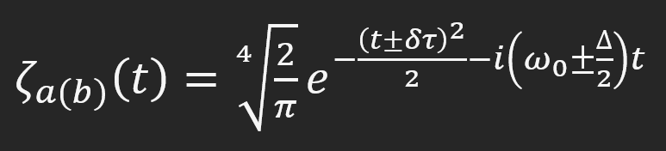
The Photon - 3
Gave rise to Temporal Mode Functions
Mode Function Defined by LWKR

Slide 13

The Photon - 4
$δτ$ is the temporal separation between photons
$ω_{0}$ is the central frequency between photon a and b
$∆$ is the separation between photons a and b

Slide 14
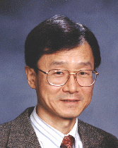
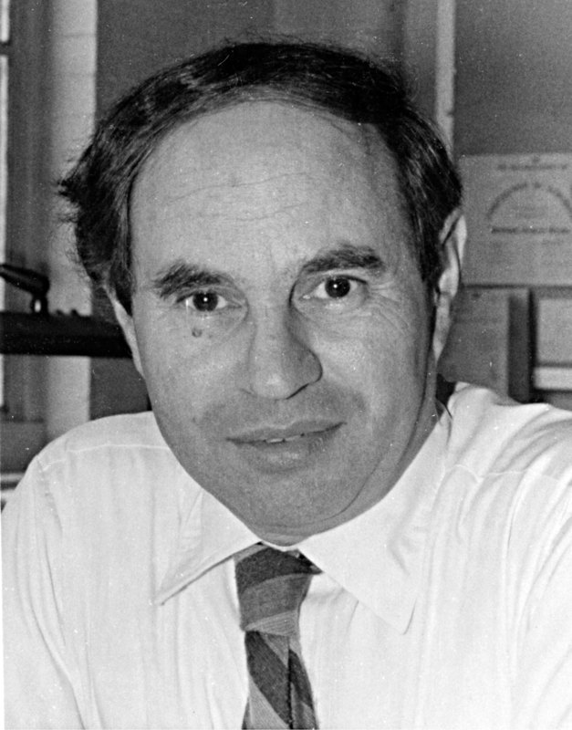

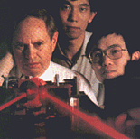
The HOM Experiment - 1
Conceived by Chung Ki Hong, Zheyu Ou, and Leonard Mandel in 1987
Landmark Experiment in Quantum Optics

Slide 15
The HOM Experiment - 2
Two Photons are Incident Upon a Beam Splitter
Output Beams are Incident Upon a Photodetector
Delay between Detections Measured

Slide 16
The HOM Experiment - 3
Found that if there was no temporal separation and the photons were indistinguishable – Coincidence counts were nonexistent
Purely Quantum Effect
https://www.mdpi.com/1424-8220/20/12/3475/htm

Slide 17
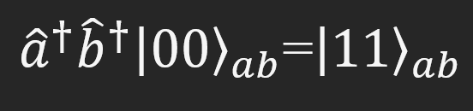
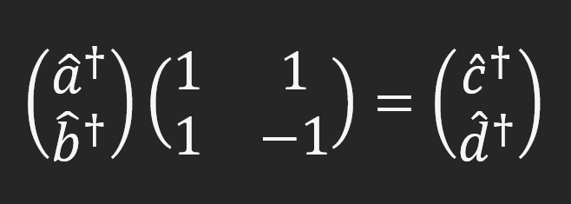
The HOM Experiment – The Math - 1
Photon Creation – Creation Operators Acting on Vacuum State
Beam Splitter Transformation – From Input Photons a and b to Output Photons c and d

Slide 18
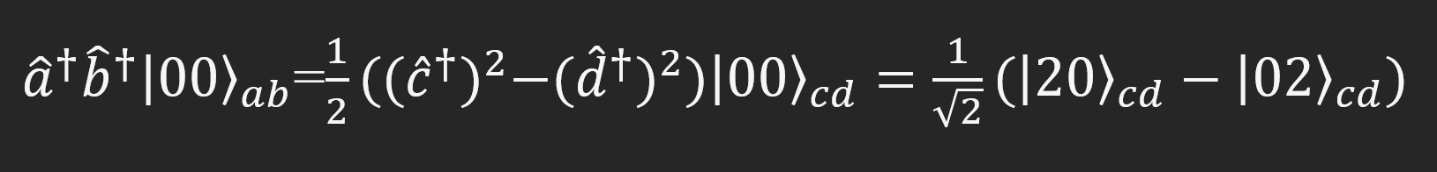
The HOM Experiment – The Math - 2
Final Result of the HOM Experiment – No Coincidence Counts!

Slide 19
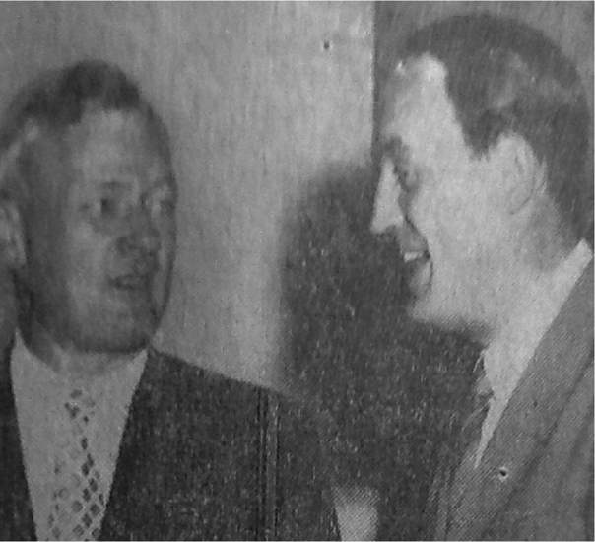
The Second Order Correlation Function
Motivated by the Experiments of R. Hanbury-Brown and R. Twiss
Wanted to Prove that a Beam Splitter was Sufficient to Determine Star Size
Found that Input Intensity was Proportional to Output Current Fluctuations

Slide 20
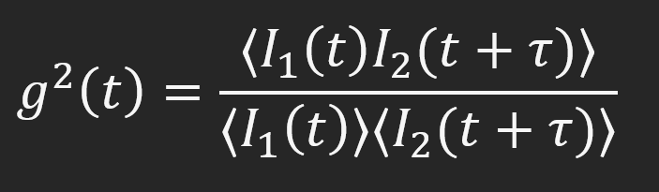
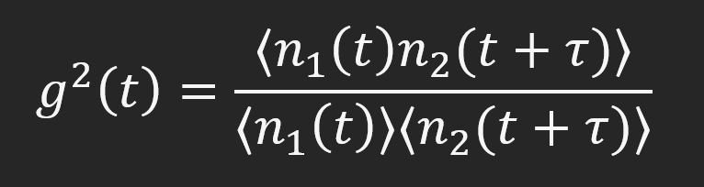
Second Order Correlation Function - 2
Output Modelled via Second Order Correlation Function
In Quantum Optics, Photon Counting used Rather than Intensity

